Slide 1

Prevent, radicalisation and colour-blindness: Racism and psychology in 21st century practice
Dr Tarek Younis
Lecturer, Middlesex University
Project funded by
Newton International Fellowship
British Academy & Royal Society

Slide 2
ON race, Institutional Racism and Colour-blindness
Race symbolizes social conflict and interests, groups are racialised according to conflicts
Islamophobia: partly rooted in racism, signifiers through:
  War on Terror, integration, cultural backwardness, etc.
Colourblindness: a form of institutional racism whereby racialisation is dismissed/erased when it matters
How does Islamophobia enter NHS?
  1. Muslims hegemonically associated with threat
  2. Clinical interactions not immune to public logic: “clinical mindlines”
    example: Muslim woman sees therapist

Slide 3
Research
20 months ethnographic fieldwork around Prevent in health:
workshops, policy documents, manuals, training
includes NHS staff and British Muslim individuals interviews
Questions:
How does radicalisation enter clinical logic and impact professional/patient space?
How do NHS staff experience counter-radicalisation training?
How are British Muslims navigating securitisation of healthcare settings?

Slide 4
Institutional Racism in Practice
Younis, T. & Jadhav, S. (2019). Islamophobia in the National Health Service: an ethnography of institutional racism in PREVENT’s counter-radicalisation policy. Sociology of Health and Illness. https://doi.org/10.1111/1467-9566.13047

Slide 5
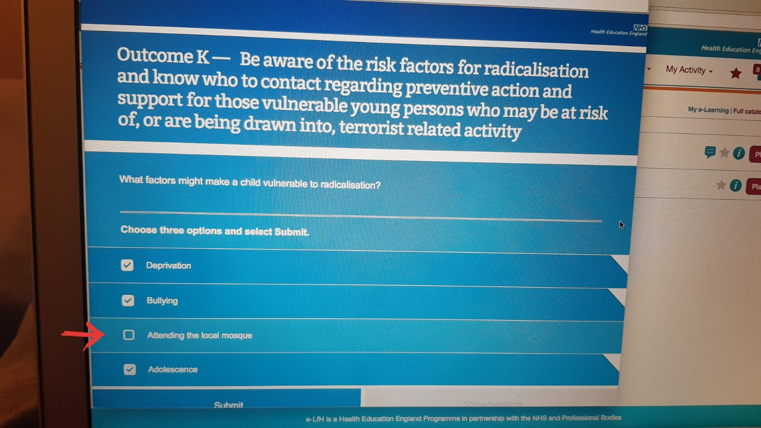
Prevent Training: Performative Colorblindness
Training (n=4):
Two forms of performative colorblindness:
  [pictured] Raising and erasing of normative association between radicalisation and Muslims
  Anyone can be radicalized, framed through positivist discourse of psychological vulnerability

Slide 6
Prevent in Practice: Cases of racism
Mary: White, female GP and the case of home schooling
nature of thresholds
self-censorship because critical – defensive medicine
nature of Prevent statistics
Cindy: BME, female psychiatrist and the case of the convert
converts as disrupting political construction of Britishness
austerity, over-regulation
Hamza: BME, male psychiatrist and the case of the White man who hates homeless
favoring certain ‘violences’ over others
privilege of Whiteness

Slide 7
Racialized Self-censorship:
Exploring Racialized Depoliticization in the NHS
Open Access Article:
Younis, T., & Jadhav, S. (2019). Keeping Our Mouths Shut: The Fear and Racialized Self-Censorship of British Healthcare Professionals in PREVENT Training. Culture, Medicine, and Psychiatry. https://doi.org/10.1007/s11013-019-09629-6

Slide 8
1. Fear in the NHS:
Politics, morality and race
S: And my worry is I’m frightened. I’m frightened of putting my head above the parapet... I’ve been asked to sign [redacted]. I’m frightened. I’m frightened of naming myself. I have spoken to various people, including my own professional body to say what they [the Home Office] are doing. They’re aghast about it all, but they’re not getting involved, so there is a collusion of anonymity.
TY: What is it you’re frightened of?
S: I’m frightened I’ll be targeted by the political powers. I’m frightened I’ll be attacked in the press, that I will be excluded, that I will be taken to be a terrorist friend and that it will be completely misconstrued.”

Slide 9
1. Fear in the NHS:
Politics, morality and race
“Why are we doing this?” – “We’re trying to save lives”
“It’s almost like, if you’re anti-PREVENT, you must be pro-terrorism. ‘Admit you’re a terrorist sympathiser.’ That’s the other one I’ve had. ‘You’re a terrorist sympathiser.’ Well, no, because the two are totally separate.”
“I’m not the person who’s making the referrals but I’m the person people are referring to PREVENT, for example. [...] But for me it is that kind of, to reiterate, the consequences of dissenting. And it’s just, you don’t feel safe. You don’t feel safe, it’s just... you don’t feel safe. You don’t feel that your colleagues wouldn’t report you.”
Case of psychiatrist of whom a complaint was filed

Slide 10
2. Reluctant trainer
“I am sympathetic to the trainer who I know because they have been delivering safeguarding training for years. And I know what happens when they get told by someone pretty high up that on this year's agenda we have to cover WRAP [Workshop to Raise Awareness of PREVENT].”
“What I found interesting, frustrating and strange is that she [the trainer] was agreeing with people. She was saying, I have to give this training, but I totally agree with you: it is outrageous. […] And she’s saying, ‘well, I completely agree, and it is Islamophobic, and it is targeting a community, and it’s important that we have this conversation, that why we’re talking about this, but here it is: it’s mandatory. I have to give this training.’ […] I and a few other people raised concerns about confidentiality, accountability, the lack of evidence-based.”

Slide 11
3. The Distrustful Setting
“I don’t want to make myself vulnerable, I don’t want any situation where I have a superficial relationship with people and then discover that actually, ‘no, they might be sympathetic to the government PREVENT policy and they might believe that it’s appropriate for Muslims to be referred to PREVENT.’ And then that would upset me. And I want to protect myself.”
“These were my thoughts. I don't know what the others thought… but I could never have a discussion. I can discuss it with friends, if you know them. […] So, I didn't ask anyone, and I had not a chance to speak of this [PREVENT] with anybody. Now it’s more than six months I'm working here.”

Slide 12
4. Austerity and the Overworked Mind
“My view [is] that 99% are just going to ignore this stuff. In my job, in particular, there are lots of things which I could potentially do, and you have to pick what you’re going fight for, if you know what I mean.”
“Not just PREVENT, but things like patient satisfaction managers, complaint managers, in the managerial culture that sets itself up to account for the activities of dwindling clinicians. And I actually see the decline of the NHS services as a direct result of counting measures.”

Slide 13
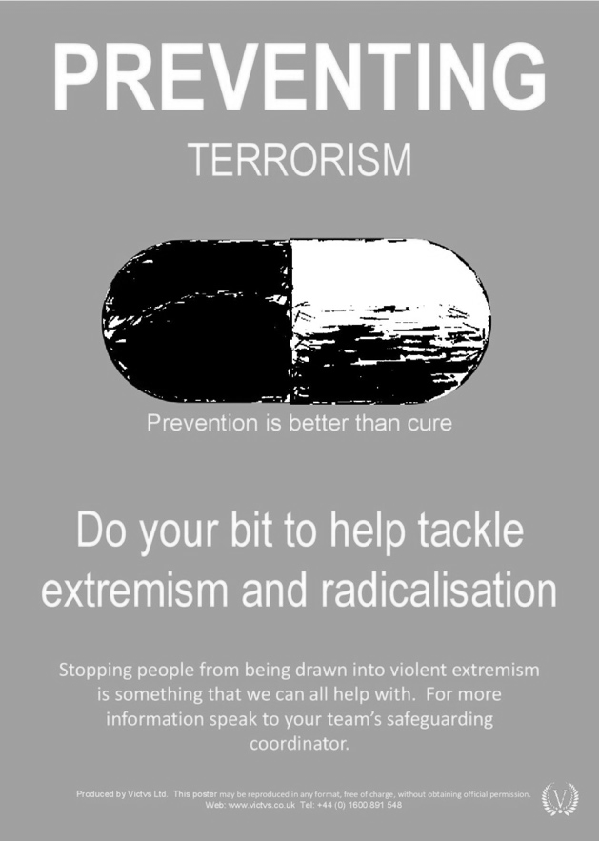
Prevent Documentation: a case of Psychologisation
NHS a “pre-criminal space” and the logic of big data
  1. emphasizing mental health professionals
  2. psychologisation: self-esteem, lack of identity, grievances
  3. mental health is about increasing resilience to ideological viruses
  4. institutionalising ”gut feelings”

Slide 14
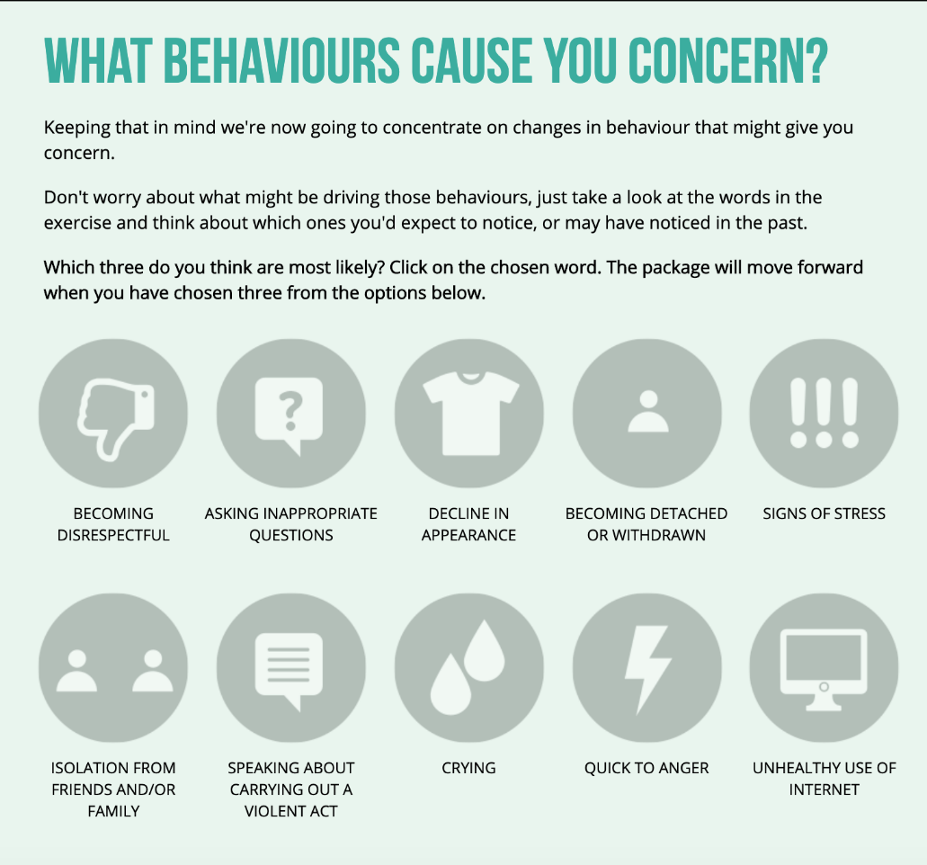

Slide 15
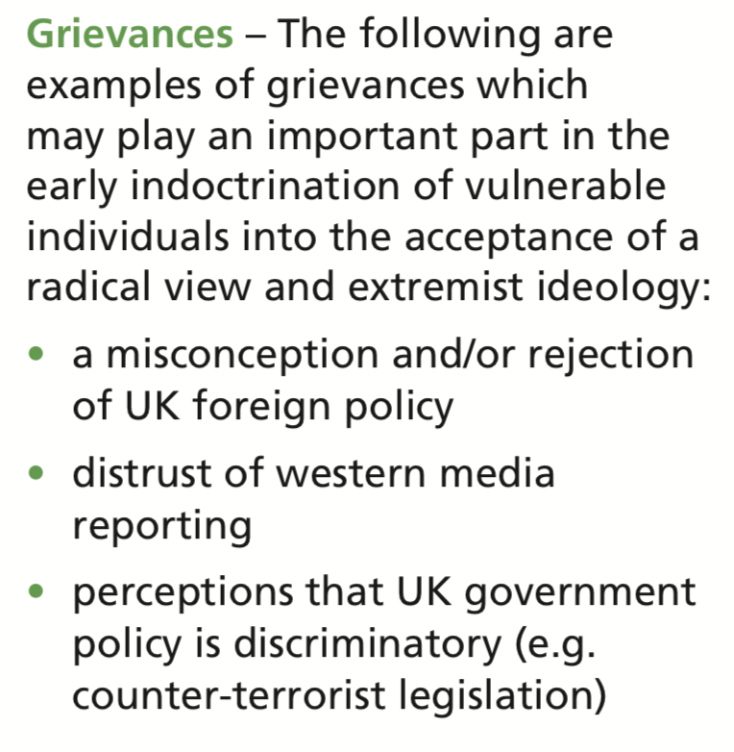

Slide 16
Framing Health: Institutional Racism
Colorblind frame in theory:
Mental health vulnerability, colorblind ideological viruses
Race frame in practice:
Brown/black suffering and racialized Muslim expressions associated with vulnerability towards radicalisation
Elusiveness of terrorism as a field consolidated by self-described experts, politically contingent and moralising: reproducing boundaries between good/evil
Terrorism associated hegemonically to racialized Muslim bodies in public consciousness; example: Brexit campaign and framing the security threat of migrants
Securitisation of integration discourse through rhetoric of counter-extremism
The myth of a post-racial society: focus on overt hate crimes, dismissing structural racism
Healthcare as an apolitical space, pre-tense of objectivity, centrality of positivism
Colorblindness serves to protect white fragility and evade charge of racism

